Slide 1
TERRITORIAL IMPACT ASSESSMENT revisited – can we make policy making more territorially sensitive?
Naja Marot and Barbara Kostanjšek
Ljubljana, 30. 9. 2023

Slide 2
Structure of the presentation
2
TIA of Policies and EU Directives, a practical guidance, link
Aims and objectives of the research
Short history of Territorial Impact Assessment and overview of current practice
Definition of TIA
The TIA approach, digital tool preparation and testing
Conclusions

Slide 3
1 Aims and objectives
3
Development and proposal for implementation of the instrument to support the harmonisation of the sectoral and other development policies with the Spatial Development Strategy of Slovenia (TIA-SI)
C01 Analysis of existing literature and good practice examples (TIA approaches, tools)
C02 Preparation of TIA approach
Assessment of the sectoral policies contribution to achieving the Strategy of the Spatial Development of the RS 2050 priorities
Assessment on different administrative levels (national, regional, municipal)
C03 Preparation of the analytical and communicative tool to perform TIA
C04 Pilot testing of the TIA approach and tool
C05 Recommendations to perform the Spatial Planning Act’s legislative guideline to check compliance of sectoral policies with the SPRS 2050 priorities => integration into existing e-Prostor platform
C06 Seminar for policy makers (May 2022, September 2023)
C07 Disemination activities

Slide 4
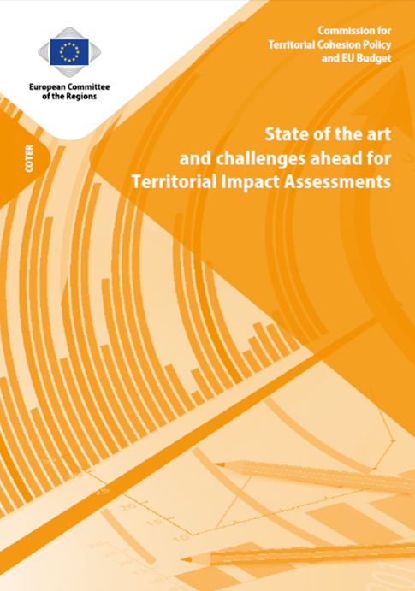
2 Short history of Territorial Impact Assessment
4
European Spatial Development Perspectives (1999): need for more balanced and sustainable spatial development of EU and for more territorialy sensitive policies and programmes
White Book on Governance (2001): need for assessment to show territorial dimension of policies
Third report on economic and social cohesion (2005): territorial cohesion as one of the main goals of EU
ESPON (2004): first research project addressing Territorial Impact Assessment (modeling impacts of TEN network on the regional development potential)
2004 onwards: development of various TIA approaches, European commission efforts for TIA
State of the art, 2020, link

Slide 5
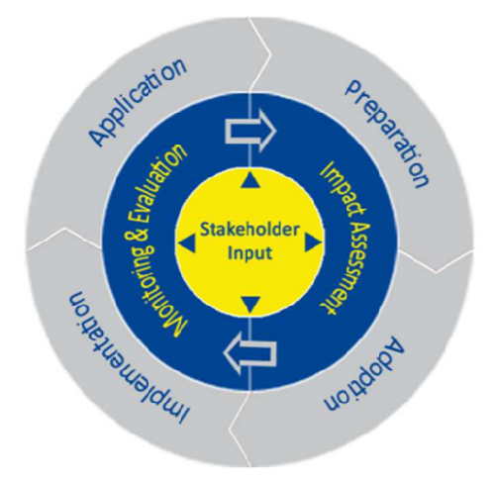
2 Territorial Impact Assessment in EU
5
Guidelines for better regulation and toolbox in support for assessment (evidence-based policy making, better and more user friendly legislation, public participation)
Spatial Foresight – forecasting challenges, risks and various measures
Impact Assessment for economy, society and environment (legislative proposals, non-legislative proposals, implementation and delegated acts)
All MS perform some sort of Regulatory Impact Assessment, shorter RIA (min. administrative burdens and financial impacts; based on questions, thematic fields and criteria; mostly obligatory for legislation)
Most of the MS without obligatory TIA, more emphasis on the environment (EU regulation)
Institutional support for assessments: The national institute for strategic policy analysis in the fields of the environment, nature and spat. planning
Source

Slide 6
2 Impact assessments in Slovenia
6
Current practice of IA in the legislative process (Igličar and Bačlija Brajnik, 2023)
Analysis of 330 legislation documents:
26 % assessment without the text;
62,5 % one-sentence assessments – »No impacts foreseen«, altogether 90 % cases without analysis.
10,9 % one-sentence, shorter analysis (descriptive method),
0,6 % detailed analysis (descriptive method).
No detailed analysis nor quantitative approaches.
Increase in share of assessment in the one-sentence format – “Impacts are not foreseen.

Slide 7
2 Impact Assessments in Slovenia
7
Factors, conditioning performance of assessments in the regulatory and policy making process

Slide 8
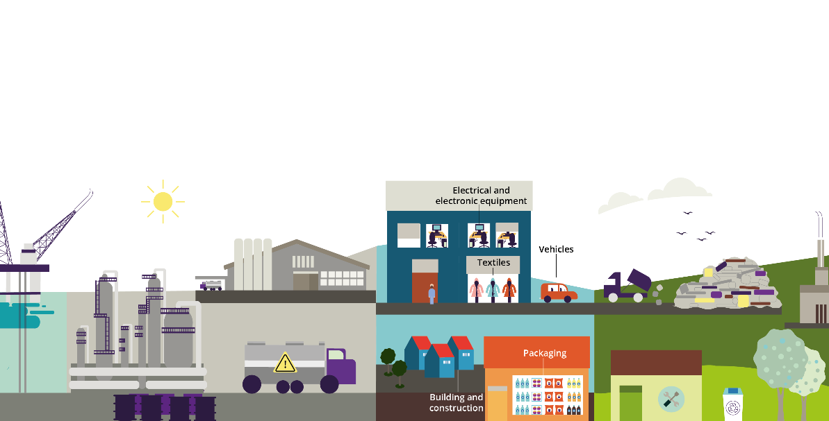
3 What is Territorial Impact Assessment?
TERRITORIAL IMPACT = each impact effecting the land use and territory, and/or their management, or broader an impact on economy, society and environment in the selected territorial unit which is a consequence of policy and/or legislation implementation, adopted on the EU, state or other governance level.
TERRITORIAL IMPACT ASSESSMENT = an assessment approach which provides identificiation of the territorial impacts on the national, regional and local level. In addition, it shows the difference in potential impacts on various areas which represent „territorial dimension“ of the assessed regulation. It can be performed in advance (ex-ante), in between (ex-durante) or after the finalised implementation of one‘s policy (ex-post).
Vir
Vir

Slide 9
3 Territorially sensitive impact assessment tools
9
Raumordnungsverfahren (Germany), Sustainaibility Impact Assessment (Switzerland, since 2004), integration of regional development aspects, nature and quality of life into RIA (Estonia, since 2012)
EQUIVALENT LIVING CONDITIONS CHECK, ELC Check (DE, since 2018) = aims at achieving concrete improvements in many areas of life for the people outside of metropolitan areas; a guidelines in legislation, non-binding;
Factors to consider financial situation of the municipalities, economy and innovation, mobility and digital infrastructure, vital services, engagement, Cohesion and participation, spatial structures and housing, natural resources
RURAL PROOFING (EC) = Assessment of positive or negative, direct and indirect impacts and implications on rural jobs, development prospects, social well-being, equal opportunities for all and the environmental quality of rural areas and communities; making policies fit for purpose for those who live and work in rural areas

Slide 10
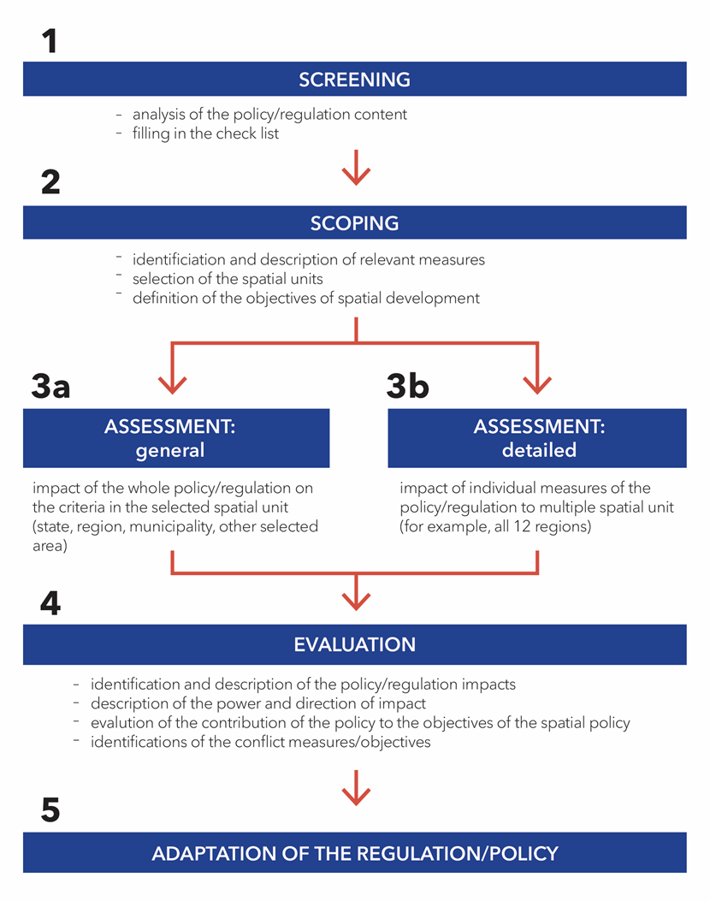
10
4 Territorial Impact Assessment approach
QUICK CHECK TIA
DETAILED TIA
SUMMARY

Slide 11
4 Territorial Impact Assessment approach
11
Approach consists of two parts:
Quick check TIA-SI (policy description, qualitative impact assessment, compliance check of the sectoral policy/legislation objectives with SPRS2050 priorities, assessment of the impacts of sectoral policy on achieving priorities of SPES, assessment of how territorially sensitive the measures of selected policy are, selection of criteria for detailed assessment; assessment of the impact on different type of territories) and
Detailed assessment TIA-SI (numeric assessment of the impacts based on defined criteria in the selected area)
In between: decision about the detailed assessment TIA-SI on the basis of the qualitative criteria
After the two phases: preparation of the summary of the assessment and the concluding score.

Slide 12
4 Territorial Impact Assessment approach
12
Quick check TIA
Form includes 7 questions:
Abstract of the policy’s/legislation content (aims, objectives, measures)
General – qualitative impacts assessment (economy, society, environment and territorial governance)
Compliance check of the policy’s/legislation objectives with priorities of the Strategy of the Spatial Development of the RS (matrix)
Policy’s/legislation impact on achieving SPRS priorities (non-obligatory question)
Identification of measures of selected policy/legislation with territorial impacts (number of measures, nature of impacts) (non-obligatory question)
Identification of detailed criteria for assessment
Identification of areas, on which the policy/legislation will impact (level of urbanization, development level, cross-border aspect)
Decision about the detailed assessment (questions 3, 5, 6, 7)
TIA is obligatory.
TIA is recommended.
TIA is unnecessary.

Slide 13
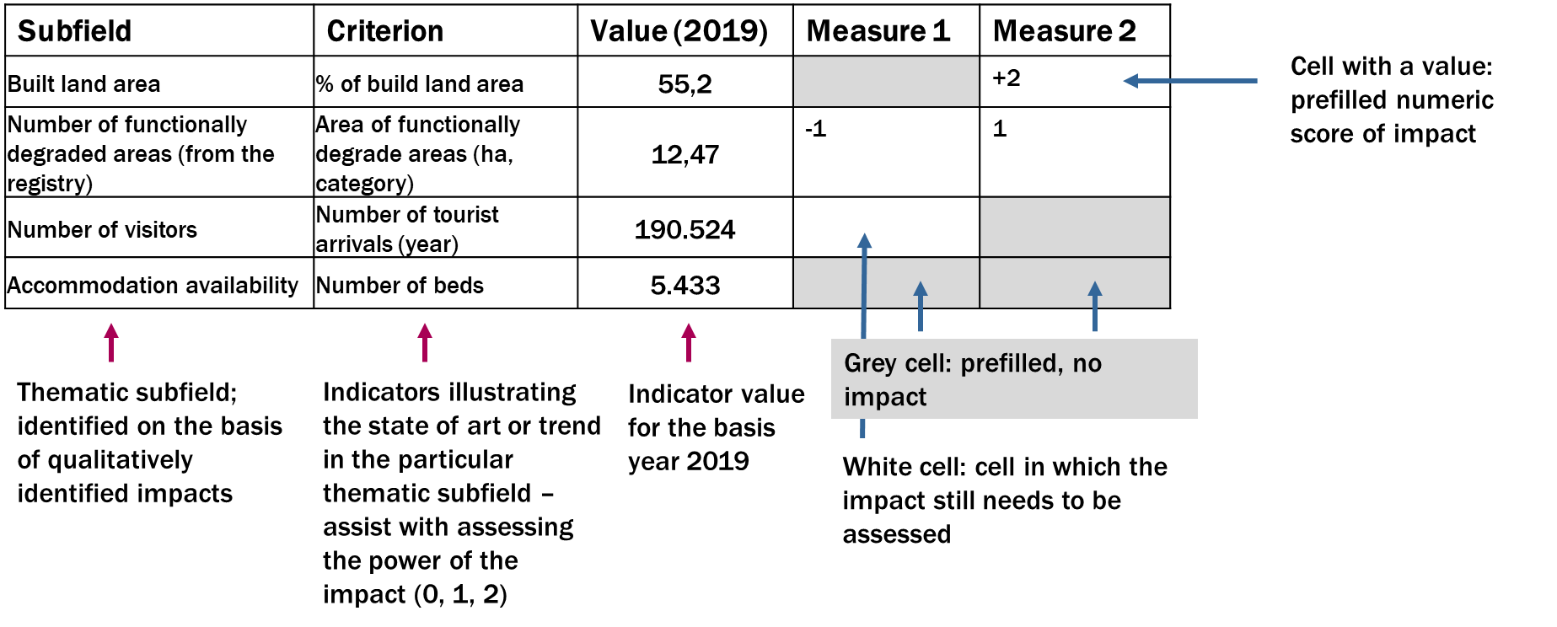
4 Territorial Impact Assessment approach
13
Detailed assessment TIA-SI
Assessment for each type of territory or territorial unit separately.
Assessment is done for subfields, selected in the quick check, and for criteria, identified for each of the subfields.
Assessment of direction (positive/negative) and power of the impact (-2, -1, -1/1, 1, 2, 0 – no impact, I cannot assess.)
Each numeric score needs to be explained.

Slide 14
4 Territorial Impact Assessment Approach
14
Summary
Summary of the scores (compliance with priority, impact on priorities, selected subfields and impact on type of areas)
Exposure of potential negative impacts on priorities of SPRS 2050 and proposal of necessary adaptations of the policy/legislation (preparation process, renovation)
Concluding evaluation of the joint contribution of the policy/legislation to achieving the priorities SPRS 2050 (minor/moderate/major impact)
Input for the results’ database
Production of .pdf report of the whole assessment
Possibly to submit comment to the tool

Slide 15
4 Preparation of the digital tool for TIA
15
Analysis of the existing practice of TIA and related tools
Testing of the ESPON Quick Check tool and the ESPON assessment tool
Testing of the German approach “equivalence living condition check” (Agricultural Land Act, Spatial Planning Act, Act on Comprehensive Transport Planning)
Preparation of Slovenian approach (quick check + detailed assessment)
Testing of Slovene approach in two variants (Agricultural Land Act, Strategy of the transport development of RS until year 2030, Common Agricultural Policy in Slovenia, 2021-2027)
Improvement of Slovenian approach Development of the tool and testing on regional and local policies
Checking of the possibility for integration of the tool into governmental cloud/e-Prostor platform/MOPED – modular digital tool for legislation preparation
Feedback from tests in regards to usefulness, content adequacy and comprehensiveness of the approach
Feedback about technical possibilities to prepare and implement the digital tool

Slide 16
4 Use of the tool in the practice
16
Currently still in the development-testing phase
Available to national administration, regional development agencies and municipalities to use in the policy making process
Ministry of the Natural Resources and Planning in charge of the tool implementation
Foreseen partial integration into the digital process/assessment related to the legislative procedure
Foreseen full integration into the e-Prostor platform

Slide 17
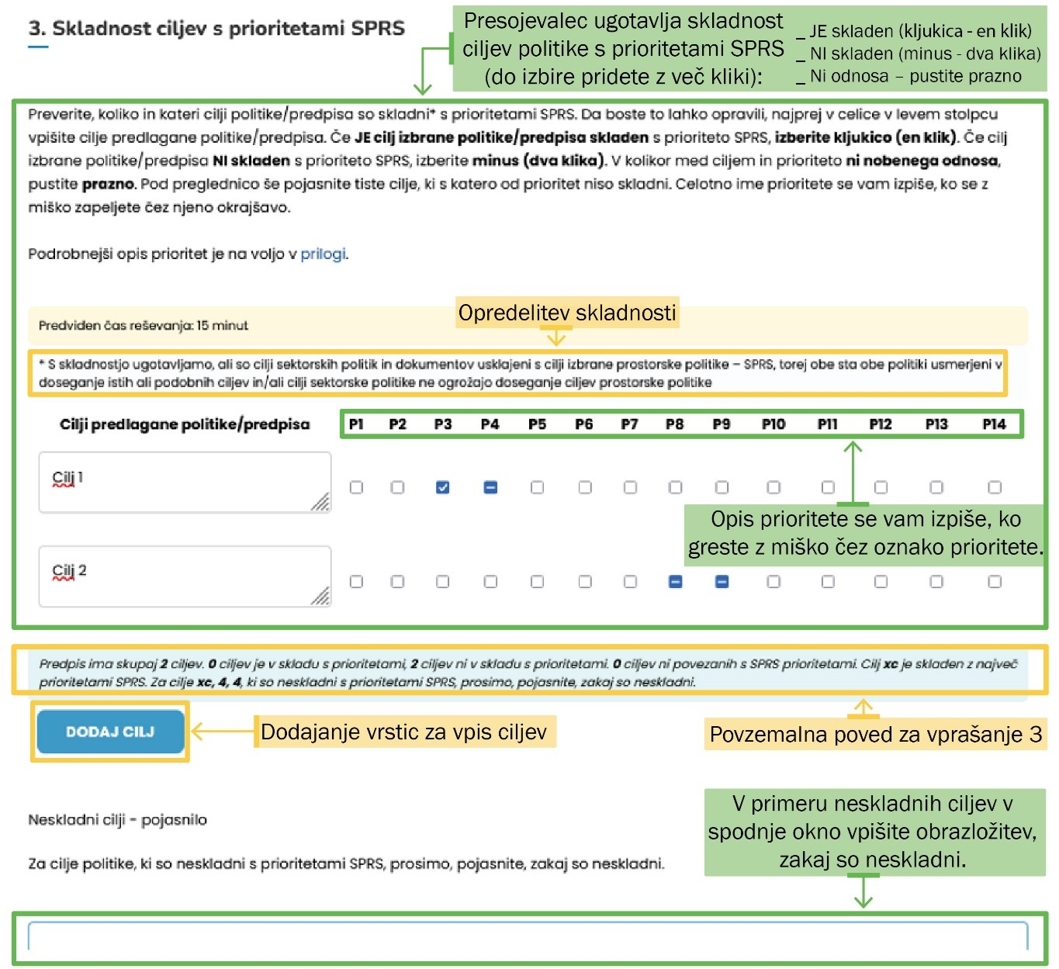
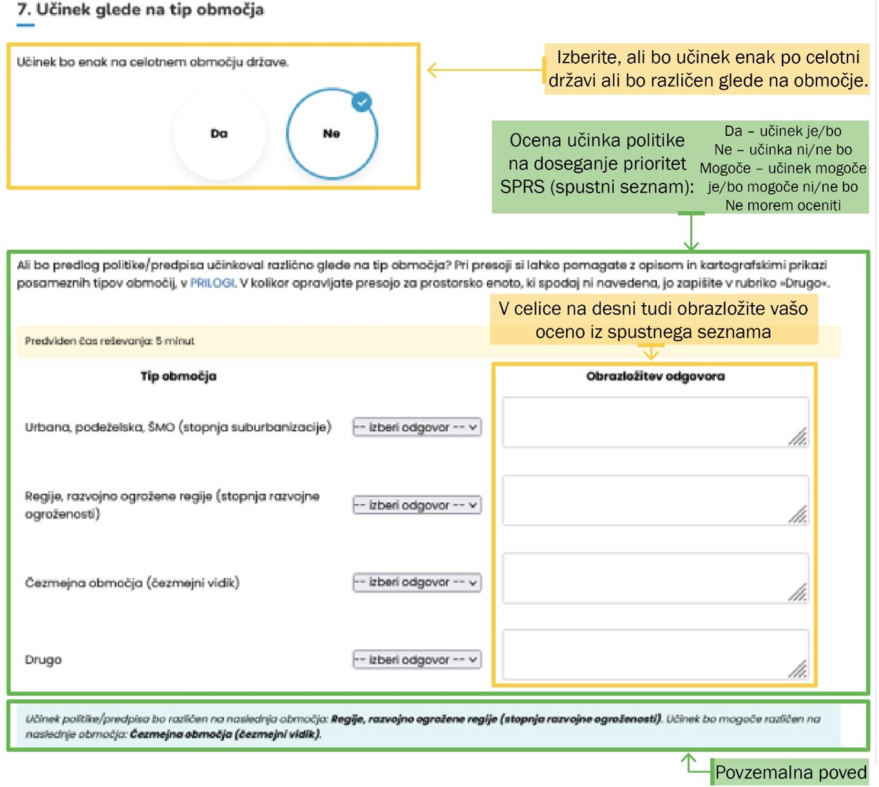
4 Use of the tool in the practice
17

Slide 18
5 Conclusions
18
How can the Territorial Impact Assessment approach in the policy making process assess to what extent sectoral policies will contribute to achieving the goals and priorities of the new Spatial Development Strategy of Slovenia and to what extent they contradict them?
Adapted Territorial Impact Assessment for the purposes of the SPRS2050 according to its content and provisions - > the quick check takes into account the priorities, areas, type of areas; A more detailed assessment includes existing indicators for monitoring the situation in territory The procedure enables the identification of positive and negative impacts and conflicts between the objectives of the evaluated policies/regulations and the priorities of the SPRS 2050 The approach also requires an explanation and addressing of the potential negative impacts and conflicts and an adaptation of the evaluated policy/legislation For such a qualitative TIA, one needs approximately 1 to 2 days; with a good knowledge of the policy/regulation, even less.

Slide 19
5 Conclusions
19
2. Should the proposed sector-policy Territorial Impact Assessment be adapted for application at different administrative levels (national, regional or municipal level) and how?
Testing has shown that the tool is useful and appropriate for the use on the national, regional and local level (and does not need to be adapted).
The tool enables the assessment of the impacts on the level of the whole Slovenia and for the selected individual territorial unit as well (possible to carry out multiple detailed assessments, namely, to assess the impacts in several territorial units)
Representatives of the regional development agencies have recognized tool as useful in the cases of regional spatial plans preparation and the preparation of regional development programmes (testing carried out)

Slide 20
5 Conclusions
20
TIA useful to bring evidence about (potential) territorial impacts of sectoral policies/legislation → another outlook on the sectoral policy on all administrative levels
TIA tool can both identify territorial sensitivity of the sectoral and other development policies/legislation and encourage sectoral representatives to be more territorially sensitive
Use of the tool can prevent territorially conflicting policy measures and measures depleting territorial cohesion
„Meditation tool“ providing the dialog between the spatial planning and other sectors ← SPRS2050/Territorial Agenda 2030
Illustration: Manca Krošelj

Slide 21
Thank you for your attention.
Contacts:
Naja Marot, naja.marot@bf.uni-lj.si, +386 1 320 30 75
Barbara Kostanjšek, barbara.kostanjsek@bf.uni-lj.si, +386 1 30 78

