Slide 1




Strengthening VOPEs' capacities in Europe: A practical approach for streamlining the evaluation of Key Horizontal Principles (KHP)
5th Biennial Conference of the Western Balkans Evaluators’ Network (WBEN)
Ljubljana, September 29-30, 2023

Slide 2
The project
The project aimed at strengthening the cooperation among VOPEs through developing Common Reference Framework – a tool that would support VOPEs in advocating for the implementation of the key horizontal principles of evaluation (ex. gender equality, prevention of discrimination, sustainable development, etc.).
The project “Strengthening VOPEs' capacities in Europe: A practical approach for streamlining the evaluation of Key Horizontal Principles (KHP)” was conducted by VOPEs from 8 European countries Austria, Germany, Greece, Italy, North Macedonia, Poland, Serbia and Spain.
The project was funded by the IOCE and Evalpartners under the Peer-to-Peer (P2P) Grants Program 2021 - Evaluation as an agile tool for an appropriate response in uncertain times.

Slide 3
The partners
Konstantina (Tina) Orfanidou & Prof. Vivienne Boufounou, Hellenic Evaluation Society (HES)
Mihajlo Djukic, Informal Network of Evaluators Serbia (INES)
Aida El Khoury de Paula, Iberian Association of Professional Evaluators (APROEVAL)
Angela Wroblewski, DeGEval – Evaluation Society (Gesellschaft für Evaluation e.V.)
Monika Bartosiewicz Niziołek, Polish Evaluation Society (PES)
Vlatko Danilov, Macedonian Evaluation Network (MEN)
Nicola ORLANDO, Italian Evaluation Association (AIV)
Danièle Lamarque, Chief Editor of the Management and Finance Review, Member of the European Court of Auditors, Chair of the European Evaluation Society (EES) Jan 2020 - Dec 2021
DeGEval – Evaluation Society (Gesellschaft für Evaluation e.V.)
Hellenic Evaluation Society (HES)
Iberian Association of Professional Evaluators (APROEVAL)
Informal Network of Evaluators Serbia (INES)
Italian Evaluation Association [Associazione Italiana di Valutazione (AIV)]
Macedonian Evaluation Network (MEN)
Polish Evaluation Society (PES)

Slide 4
The tasks
Mapping VOPEs throughout Europe: in a P2P stocktaking exercise (desk research, remote meetings/interviews with VOPEs), it was explored how VOPEs consider KHPs in their strategic documents (e.g., statute, mission statement, standards, guidelines).
SWOT and GAP analysis: in a P2P reflection, areas for improvement for VOPEs, regarding KHP, were identified.
Draft Common Reference Framework CRF: a CRF was developed comprising areas for action
Translation of the CRF to the participating VOPEs’ languages to support its adoption and dissemination at VOPE level, is in process.
Dissemination (in progress)

Slide 5
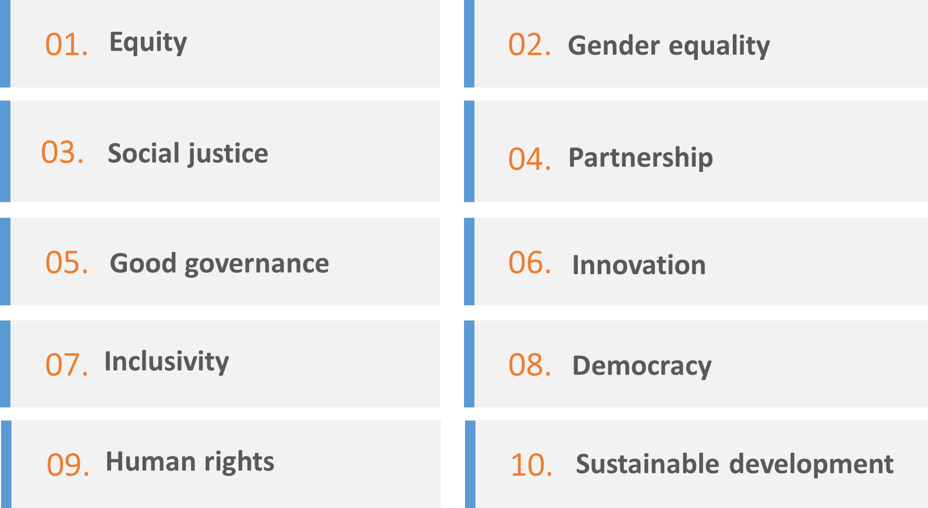
The Key Horizontal Principles KHP

Slide 6
The landscape survey
Participating Countries
Bulgaria
Germany/Austria
Greece
France
Italy
Latvia
Luxembourg
N. Macedonia
Norway
Poland
Serbia
Spain
Switzerland
Ukraine
Qualitative field research was performed among European countries. The Survey Tool consisted of 8 sections.
In the first section, VOPE representatives were asked about their overall perception of the KHP evaluation practice in their respective countries.
Second section provides self-assessment of the activities that specific VOPE perform to promote the evaluation of KHPs in practice including advocacy, collaborations, declarations, documents developed, etc.
In the third and fourth section, VOPE representatives were inquired to provide and elaborate in more details specific areas through which they contributed to greater use of KHPs in evaluation matters.
Within the fifth section, VOPEs provided specific documents developed to tackle KHP in the local evaluation practice.
In the sixth section, VOPEs were asked to suggest elements to be included in development of the common reference framework (e.g. support to readiness, to knowledge intensity, etc.) based on their experience.
Finally, seventh and eight sections provided national regulative and other important documents that could be useful for understanding the existing policy environment and for developing common standards.

Slide 7

The findings from the landscape-SWOT
Strengths |  | Weaknesses
Dedicated IOCE funded project, acting as a tool for ‘as is’ assessment in European countries European acquis Advanced methodological approaches for certain KHPs (e.g., gender) |  | No clear perception of the KHPs throughout European VOPEs-limited visibility of the KHPs evaluation practice No clear commitment of the VOPEs to the promotion of the KHPs Fragmentation in VOPEs related activities Many VOPEs and NESE members still do not have developed documents and/or guidelines to support advocating for greater use of evaluation evidence or to help local evaluators Very small correlation to evaluation standards and professionalisation framework Disparate practices in the use in evaluation practices at national level
Opportunities |  | Threats
Greater use of evaluation evidence in policy processes requiring greater awareness about the benefits of evaluation, as well as fundamental principles that should be followed IOCE, EES and NESE action in order to promote the KHPs in evaluation Practices Development of a guidance document for VOPEs capacity building and for streamlining KHPs in evaluation Exchange of good practices shared by more advanced countries Thessaloniki Declaration expansion in more countries and a specific action plan |  | No further action taken to change the current situation Lack of focused and/or integrated approach throughout Europe

Slide 8
The findings from the landscape-GAP

Slide 9
Synthetic findings
Importance: KHPs should be considered and integrated into all interventions’ and policies’ evaluation.
Disparities: In the vast majority of countries, there is no clear perception of the KHPs and limited visibility in their promotion or in the evaluation practices.
Lack of clear commitment: A fragmentation has been identified in VOPEs activities. Not so many developed documents and/or guidelines to support advocating for greater use of evaluation evidence in local policy making processes or to help local evaluators dealing with diverse contemporary challenges.
Evaluation standards: There is limited evidence for the integration of KHPs in evaluation standards and in the professionalisation framework, even though trainings and development of tools are undertaken by a small share of VOPEs.
Thematic evaluations: Greater progress has been identified for principles related to issued methodological guidance documents, such as gender, inclusivity, partnership and sustainable development.
Streamlining: There seems to be an important need for streamlining the KHPs and for effort to be put in increasing awareness and visibility activities of the KHPs, along with specific action for commitment to their promotion.

Slide 10
The Common Reference Framework-CRF
What is the CRF?
The Common Reference Framework - CRF´ for Key Horizontal Principles in Evaluation is a Position Paper for setting the necessity and the ground for developing quality and credible evaluations, respectful of all their stakeholders, “leaving no one behind“, and applicable to each and particular cultural and political context.
The CRF is a practical tool not only for VOPEs in Europe to identify appropriate action in enhancing their current capabilities and ensure the sustainability of professional competences regarding the key principles but also for NESE in order to undertake coordinated action for exchange and monitoring of progress in the field.

Slide 11
The CRF recommendations
Recommendation 1 Increase awareness regarding relevance of KHPs as evaluation quality criteria within the VOPE.
Recommendation 2 Declare VOPE’s commitment in embedding KHPs in evaluation practice through the formulation and adoption of a specific declaration.
Recommendation 3 Organize specific VOPE activities to promote KHPs in general or specific KHPs in evaluation.
Recommendation 4 In case there is a National Evaluation Policy/Plan in place, use this as a starting point for a discussion regarding the relevance of KHPs with relevant national authorities.
Recommendation 5 Support advocacy and a discourse about the relevance of KHPs within the VOPE.

Slide 12
The CRF recommendations
Recommendation 6 Provide support on how to consider KPHs when commissioning or conducting evaluation.
Recommendation 7 Provide good practice and dedicated resources focusing on KHPs as a cross-cutting issue.
Recommendation 8 Increase awareness among VOPEs regarding the relevance of KHPs which goes beyond focusing on selected KHPs. Provide support to VOPEs for developing concrete actions to consider KHPs as a cross-cutting issue in evaluations.
Recommendation 9 Increase the visibility of the Thessaloniki Declaration among NESE members and communicate the relevance of KHPs.
Recommendation 10 Expand the list of KHPs included in the Thessaloniki Declaration.

Slide 13

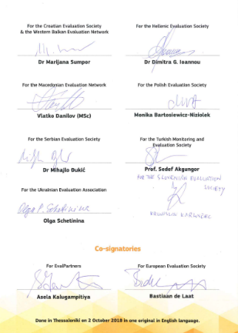
Thessaloniki Declaration-DRG Evaluation

Slide 14
Public discourse
Question 1 Why are KPHs important?
Question 2 What do VOPEs need for streamlining KPHs? What kind of support or tools are needed?
Question 3 Who might be the key actors involved in steamlining?
Question 4 What are the challenges and the drivers?
Question 5 What is expected from NESE?

Slide 15
Strengthening VOPEs' capacities in Europe: A practical approach for streamlining the evaluation of Key Horizontal Principles (KHP)
Thank you for your attention

