Slide 1
Monitoring, evaluation and impact assessment of the EU funded programme GeoERA
Barbara Simić and Jasna Šinigoj
Geological Survey of Slovenia
5th Western Balkan Network of Evaluators (WBEN) Conference, Ljubljana, 29. – 30. 9. 2023

Slide 2
Presentation summary
Introducing GeoZS and GeoERA
Evaluation goals
GeoERA monitoring and evaluation framework
Monitoring and evaluation results
Impact assessment
Main findings
GeoERA continues

Slide 3
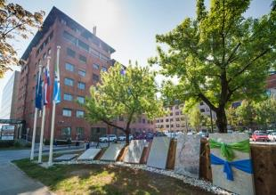
Geological Survey of Slovenia
Legal status: Public Research Institute
Owned by Republic of Slovenia
Founded in 1946
Currently 122 employees
Research & development
Market
Public services
fundamental scientific research
applied research, explorations, and studies
international cooperation
provision of public services
transfer of the knowledge into practice to support national and local authorities’ decisions and economy

Slide 4

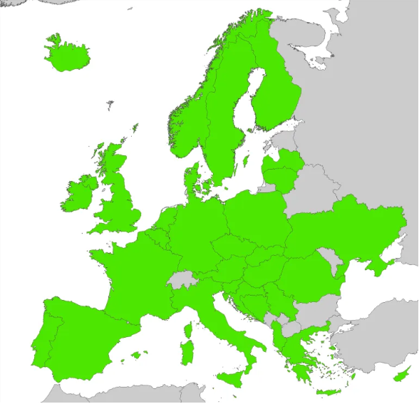

GeoERA - Establishing the European geological surveys research area to deliver a geological service for Europe
Overall goal: to integrate the GSO‘s information and knowledge on subsurface resources, to support their sustainable use in addressing Europe‘s grand challenges
47 national and regional Geological Survey Organisations from 32 European countries
31 mio EUR; 1. 1. 2017 – 28. 2. 2022; Secretariat: TNO, GEUS, GeoZS and BGR
In 2017 a two-stage joint call for projects was launched and
15 projects were selected (1. 7. 2018 – 31. 10. 2021) in 4 themes:
Geo-energy, raw materials, groundwater and information platform
As part of GeoERA secretariat GeoZS took over WP 4: Follow-up and monitoring of the projects
This project has received funding by the European Union’s Horizon 2020 research and innovation programme under grant agreement No. 731166.

Slide 5
Evaluation goals
measure improvement in GeoERA
develop a methodology for cross-sectional assessment of impacts that will provide a measure of GeoERA synergies
provide groundwork for evaluation frameworks for future ERA-NETs in the field of geology
Challenges:
GeoERA is first of its kind in the field of geology
No existing basis to build GeoERA evaluation framework or data to compare it to
Complexity: 15 projects – 4 themes – GeoERA objectives - ERA NET impacts

Slide 6
GeoERA monitoring and evaluation framework
Level
ERA-NET
GeoERA programme
15 PROJECTS

Slide 7
GeoERA monitoring and evaluation framework
Level | Objectives
ERA-NET | Overall objective (long-term) = ERA-NET specific objectives
GeoERA programme | Specific objectives (medium-term)
 | Scientific objectives (medium-term) 4 THEMES Raw Materials Geo-Energy Groundwater Information platform
15 PROJECTS | Project objectives (short-term) Overall Organisational Scientific

Slide 8
GeoERA monitoring and evaluation framework
Level | Objectives | Objective example
ERA-NET | Overall objective (long-term) = ERA-NET specific objectives | Achievement of critical mass for funding of TN projects by pooling N/R resources Alignment of national R&I programmes
GeoERA programme | Specific objectives (medium-term) | Overall: To support the advancement and resilient exploitation of Europe‘s geological resources
 | Scientific objectives (medium-term) 4 THEMES Raw Materials Geo-Energy Groundwater Information platform | Organisational: - bring together the majority of European GSOs to establish European Geological Knowledge Base - initiate jointly planned research projects → Geoscience Information Platform
15 PROJECTS | Project objectives (short-term) Overall Organisational Scientific

Slide 9
GeoERA monitoring and evaluation framework
Level | Objectives
ERA-NET | Overall objective (long-term) = ERA-NET specific objectives
GeoERA programme | Specific objectives (medium-term)
 | Scientific objectives (medium-term) 4 THEMES Raw Materials Geo-Energy Groundwater Information platform
15 PROJECTS | Project objectives (short-term) Overall Organisational Scientific

Slide 10
GeoERA monitoring and evaluation framework
Level | Objectives | Indicator type
ERA-NET | Overall objective (long-term) = ERA-NET specific objectives | IMPACT indicators
GeoERA programme | Specific objectives (medium-term) | RESULT indicators
 | Scientific objectives (medium-term) 4 THEMES Raw Materials Geo-Energy Groundwater Information platform | RESULT indicators
15 PROJECTS | Project objectives (short-term) Overall Organisational Scientific | OUTPUT indicators
 |  | DELIVERABLE indicators

Slide 11
GeoERA monitoring and evaluation framework
Level | Objectives | Indicator type | Monitoring level
ERA-NET | Overall objective (long-term) = ERA-NET specific objectives | IMPACT indicators | 4 – GeoERA progress evaluation and impact assessment
GeoERA programme | Specific objectives (medium-term) | RESULT indicators
 | Scientific objectives (medium-term) 4 THEMES Raw Materials Geo-Energy Groundwater Information platform | RESULT indicators | 3 – Review of the theme progress
15 PROJECTS | Project objectives (short-term) Overall Organisational Scientific | OUTPUT indicators | 2 – Scientific review
 |  | DELIVERABLE indicators | 1 – Monitoring of progress indicators

Slide 12
GeoERA monitoring and evaluation framework
Monitoring level | Aim | Evaluator | Method
4 – GeoERA progress evaluation and impact assessment | Final Impact evaluation and general recommendations | Stakeholders Impact evaluator | Discussion with Stakeholders, Desk-based Questionnaires Interviews
3 – Review of the theme progress | Review of achieving theme Specific Research Topics. | Theme coordinators | Desk-based
2 – Scientific review | Quality review of the deliverables and review of achieving scientific and professional goals | Scientific and DM reviewers | Desk-based
1 – Monitoring of progress indicators | Monitoring of the effectiveness of implementation with respect to finance, time and administration. | Monitoring team | Desk-based

Slide 13
Monitoring and evaluation results
Statistics:
3 experts for implementation and monitoring of projects formed the GeoZS Monitoring team;
16 scientific reviewers from GeoZS; and
2 data management reviewers from GeoZS;
4 theme coordinators from GeoERA Secretariat;
24 stakeholders representing organizations from all over the world;
1 Impact evaluator + 2 assisting evaluators

Slide 14
Monitoring and evaluation results
Indicator | Original plan | Reached value | Percentage achieved
Number of deliverables | 510 | 495 | 97 %
Number of PersonMonths | 4.347,56 | 4.867,49 | 112 %
Total budget | 30.577.952,82 | 30.464.361,47 | 99 %
Theme | Number of projects | Number of GSOs | Number of countries
Geo-energy | 6 | 41 | 28
Groundwater | 4 | 42 | 31
Raw Materials | 4 | 35 | 30
Information Platform | 1 | 24 | 22
GeoERA | 15 | 47 | 32

Slide 15
Monitoring and evaluation results
Scale | Rank | Description
5 | Overachiever | The project has achieved all objectives and goals and has even exceeded expectations = exceeded expectations
4 | Excellent progress | The project has fully achieved its objectives and goals = as expected
3 | Good progress | The project has achieved most of its objectives and goals with relatively minor deviations = minor recommendations
2 | Acceptable progress | The project has achieved some of its objectives = below expectations
1 | Unsatisfactory progress | The project has failed to achieve critical objectives = expectations not met

Slide 16
Monitoring and evaluation results
Theme | 1 Monitoring | 2 Scientific review | 3 Theme review | 4 GeoERA Review | Average evaluation | Communication & Dissemination
Geo-energy | 4,3 | 4,2 | 4,2 | 4,3 | 4,3 | 3,8
Groundwater | 4,0 | 4,0 | 5,0 | 4,3 | 4,3 | 3,8
Raw Materials | 3,8 | 4,3 | 4,0 | 3,8 | 3,9 | 5,0
Information Platform | 5,0 | 5,0 | 5,0 | 5,0 | 5,0 | 5,0
Average | 4,3 | 4,3 | 4,5 | 4,4 | 4,4 | 4,4

Slide 17
Monitoring and evaluation results
Tools | CDE Key Performance indicators | Expected results in 5 years | Achievements
Website | No of unique visitors | 1500 | 73.904 visitors, 253 blog published
Social Media (LinkedIn, Facebook & Twitter) | Number of Followers, Number of Tweets | 1250 250 | Twitter: 5.140 tweets, 2.157 followers LinkedIn: 984 posts, 1.550 followers Facebook: 1.170 posts, 1.220 followers
Brochures | No of copies distributed | 5000 | Total 7 leaflets / 3350 distributed
Video | Number of views | 500 | 25 videos / 12.429 views
Conferences / events | Number of Conferences/events attended | 20 | 43 congresses & 109 activities (oral presentations, posters, abstract, article) Webinar 47, Workshop 46, Seminar 10
E-Newsletters | Number of online readers | 1500 | Total 41 Newsletters with 1064 subscribers
Articles | Number of articles published | 50 | Scientific Publications 100 (>50 Peer reviewed); Non-Scientific Publications 16, Abstracts 83, Posters 33
Stakeholder workshops/ info days | No of participants | 500 | 2530 participants

Slide 18
Impact assessment
Desk study of GeoERA programme and project documents (ex-ante)
Synthesis and analysis of findings obtained with monitoring
On-line questionnaires for assessment of impacts by 15 Project leads in December 2021
Interviews with Stakeholders about preliminary impact assessment results. They:
  Discussed the GeoERA impact evaluation plan and its instruments (at Kick-off meeting, July 2018)
  Were invited to fill out short questionnaire for assessment of GeoERA impacts and about broader contribution to ERA-NET and to Horizon 2020 (after the projects‘ end, January 2022)
Overall evaluative findings are triangulated from different assessment sources in order to frame recommendations for GeoERA

Slide 19
Impact assessment - GeoERA‘s wider social impacts
 | Geo-energy* | Groundwater* | Raw materials* | Info. platform* | GeoERA
Specific questions, total | 4,1 | 4,2 | 4,1 | 4,3 | 4,2 | Exceptional**
General questions – GeoERA contribution to:
- H2020 | 3,4 | 3,1 | 3,6 | 4,0 | 3,5 | Very good**
- ERA-NET | 4,1 | 3,9 | 4,2 | 4,4 | 4,1 | Exceptional**
- Removing obstacles to internat. cooperation | 3,1 | 3,8 | 3,8 | 3,7 | 3,6 | Very good**
- Contribution to other European Impacts | 2,9 | 3,0 | 3,2 | 4,0 | 3,3 | Moderate**
GeoERA European Impact | 3,8 | 3,8 | 3,9 | 4,1 | 3,9 | Very good**
 | Very good** | Very good** | Very good** | Exceptional** | /
*Scale: 0 – No impact; 1 – Negative impact; 2 – Weak impact; 3 – Moderate impact; 4 – Excellent impact; 5 – Outstanding impact, beyond expectations
**Scale: Poor (from 2,0 to 2,5); Moderate (2,6 – 3,4); Very good (3,5-4,0); Exceptional (more than 4,0)

Slide 20
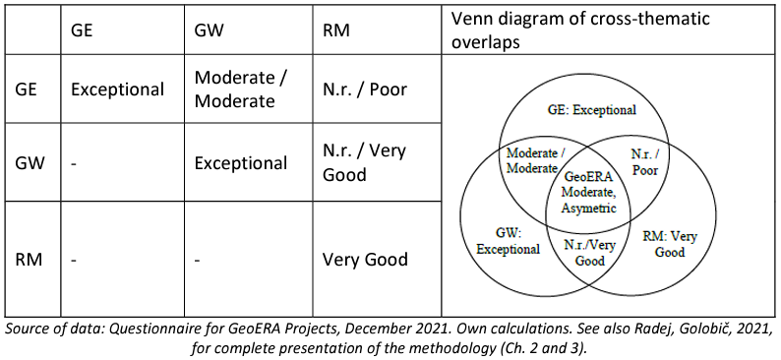
Impact assessment – Cross-Thematic Impact (innovative approach)
Cross-thematic assessment applies matrical approach (first employed by Luna Leopold, 1971, a geologist from US Geological Survey)
Intro to Bojan‘s presentation.

Slide 21
Main findings
Overall goal: to integrate the GSO‘s information and knowledge on subsurface resources, to support their sustainable use in addressing Europe‘s grand challenges
Integration: Fully achieved (cross-county networking, cross-cutting integration, cross-thematic integration)
GSO‘s information and knowledge on subsurface resources: Beyond expectations
Sustainability: Very good (ability to achieve self-sustained P2P networks without EU funding)
addressing Europe‘s grand challenges: Very good (contribution to EU Societal challenges)

Slide 22


GeoERA continues…
GeoERA‘s goal continues in Geological Service for Europe project - GSEU;
Horizon Europe CSA programme
www.geologicalservice.eu

Slide 23
Thank you for your attention!
Barbara Simić
Head of Project office
Geological Survey of Slovenia
www.geo-zs.si
www.geoera.eu
Sources for this presentation: Monitoring team‘s internal tables; Impact evaluator‘s own calculations; GeoERA Deliverable D4.7; GeoERA Deliverable D4.5

