Slide 1


www.ailyze.com
www.resultsinhealth.org
10x Your Productivity by
Using AI For Qualitative Research
WBEN5 Conference

Slide 2

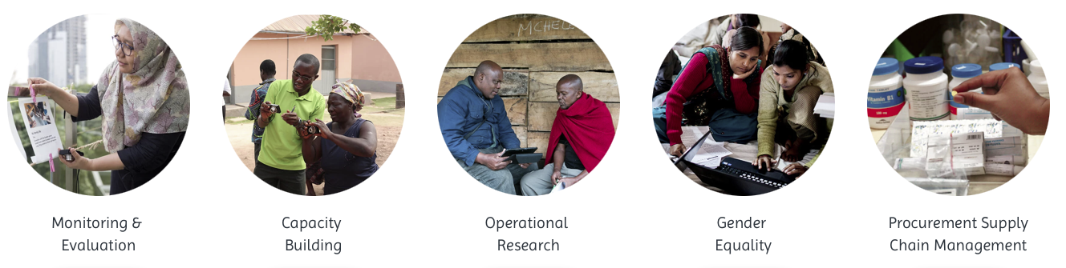
About ResultsinHealth
RiH carries our short- and long-term evaluations, operational research and trainings in the Netherlands and around the world
Nur Hidayati
Impact Team (Team Leader)

Slide 3
Agenda
Introduction to AILYZE, a new online AI tool for qualitative research
RiH’s experience using AI in qualitative research through AILYZE
Discussion on the future of AI-powered evaluation

Slide 4
Introduction to AILYZE, a new online AI tool for qualitative research
www.ailyze.com

Slide 5


Key Features of AILYZE (1/2)
Obtain answers to your evaluation questions with supporting quotes based on your interview transcripts/ program documents/ etc. in any language in seconds
Obtain detailed summaries of your program documents, evaluation reports, etc.

Slide 6


Key Features of AILYZE (2/2)
Automatically identify themes from your interview transcripts and which transcripts discussed what
Identify outcomes from interview transcripts, reports, etc., and categorize them (e.g., significant/ not significant, positive/ negative)

Slide 7
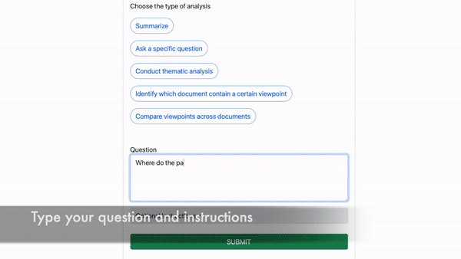
Example – Custom Analysis

Slide 8
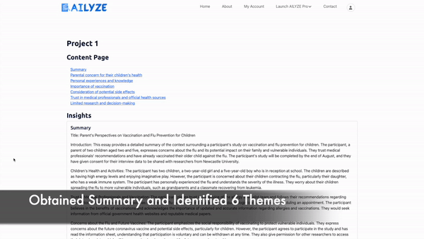
Example – One-Click Insights

Slide 9

Data Privacy
✓ GDPR and CCPA Compliant
✓ HIPAA Compliant (if you sign a BAA with us)
Your data is encrypted, so AILYZE cannot view it
Your data is not used to train our AI models

Slide 10
RiH’s experience using AI in qualitative research through AILYZE
x
www.ailyze.com

Slide 11

Overview
RiH adopted AILYZE’s Enterprise Plan
Got assigned a data scientist, who used AILYZE’s most powerful offline AI models to conduct an analysis of KIIs and FGDs (instead of self-serving online)

Slide 12
Example 1 – Outcome Harvesting
Evaluation of a Sexual & Reproductive Health & Rights Program
AILYZE analyzed ~20 stories of change (docx, ~10 pages each) from Ethiopia, Kenya, Rwanda, Uganda, and Zambia
AILYZE extracted ~200 outcomes from the documents within 2 days
  Outcome description
  Why the outcome is significant
  How the program contributed to the outcome
  Which Theory of Change pathway that outcome contributed to
  Whether the outcome is positive or negative
  Whether the outcome is intended or unintended
  Supporting quotes from the document

Slide 13
Example 1 – Outcome Harvesting
Illustrative output generated (not real data)
Docx | Outcome | Significance | Contribution | Quote1 | Quote2 | Quote3 | ToC1 | ToC2 | ToC3 | Positive_ Negative | Intended_ Unintended
Ethiopia_SoC_1 | Increased awareness about contraceptive methods | High | Direct contribution from the program | "Before this program, I had no idea there were so many contraceptive options." | "I've learned so much about how to take control of my reproductive health." | "Knowledge is power, and this program has empowered me." | Awareness | Knowledge growth | - | Positive | Intended
Ethiopia_SoC_2 | Stigmatization of unmarried women seeking contraceptives | Medium | Indirect contribution, as the program didn't address cultural beliefs | "The village elders still frown upon young girls like me going to the health center." | "I wish the community understood that it's about our health." | "Despite the stares, I'd rather be safe." | Cultural norms | Peer pressure | Fear | Negative | Unintended
… | … | … | … | … | … | … | … | … | … | … | …

Slide 14
Example 2 – Content Analysis
Evaluation of a Sexual & Reproductive Health & Rights Program
AILYZE analyzed ~80 KII and FGDs (docx, ~10 pages each) from Ethiopia, Kenya, Rwanda, Uganda, and Zambia
AILYZE generated ~800 pages of insights from the documents within 2 days
  Covered ~10 evaluation questions
  For each evaluation question, extracted insights and quotes
    Per KII/FGD
    Per Country
    Comparing similarities and differences across countries

Slide 15
Example 2 – Content Analysis
Illustrative output generated – Analysis of 1 KII for 1 evaluation question
Docx | Evaluation Question | AI Response | Quote1 | Quote2
Ethiopia_KII_1 | What are the interviewee’s views on intersectional SRHR strategies? | The interviewee believes that implementing intersectional SRHR strategies goes beyond just understanding the theory. It's about ensuring that the theoretical framework is transformed into actionable steps, whether that's in policy review or comprehensive data gathering. For the effective use of intersectionality, collaboration and agreement among stakeholders is crucial. This might prolong the process but guarantees a well-rounded perspective instead of a generic, broad-brush method. Turning intersectionality into a real-world application might be challenging, but it's essential. Overall, the interviewee views the role of intersectional SRHR advocacy as a bridge between the abstract idea of intersectionality and its tangible execution. A continuous, joint effort is necessary for achieving a mutual comprehension and implementation. | "You know, it's all about making the theoretical tangible. While I appreciate the academic framework behind intersectionality, the question remains - how can we make it actionable? Whether it's about dissecting a policy through an intersectional perspective or gathering inclusive data – these are the practical challenges we face. And just like this interview, figuring out the specifics is the real task." | "Clarity is essential, but it's not always about speed. Sometimes, getting everyone on the same page means multiple discussions, understanding varying perspectives, and finding commonality. Yes, it might seem tedious at times, but this collective approach ensures we are thorough, even if it introduces complexity."
Ethiopia_KII_2 |  | … | … | …

Slide 16
Example 2 – Content Analysis
Illustrative output generated – Analysis of similarities/differences btw countries for 1 evaluation question
Evaluation Question | AI Response
What are the interviewee’s views on intersectional SRHR strategies? | Data from Tanzania, Uganda, and Burundi highlights varying degrees of youth participation in intersectionality discussions and initiatives. In Tanzania, feedback from discussions with TAYPA (Tanzanian Youth Progressive Association) members and WASHTA+ associates demonstrates increased youth engagement in intersectionality seminars (Reporting form_Discussions with TAYPA_Tanzania 15082023.docx, Reporting form_Dialogues with WASHTA+ Tanzania 25072023.docx). Meanwhile, in Uganda, young respondents emphasize the impact of monthly webinars that deepened their understanding of intersectional issues (U1YP-Webinar Reflections Report_coding.docx). In Burundi, youth leaders at community forums mentioned pilot programs dedicated to understanding intersectionality in schools (BII 3 with Youth Community Leaders_Notes.docx). Such evidence underscores the emerging trend in these countries where youth-centric platforms are taking a lead role in driving the intersectionality discourse. As a youth leader from Burundi notes, "Over the past year, I've been part of 6 school programs on intersectionality" (BII 3 with Youth Community Leaders_Notes.docx), showcasing the momentum behind these initiatives. However, some feedback from Tanzania alludes to the need for more comprehensive youth programs that tackle intersectionality in rural areas (Reporting form_Dialogues with Rural Youth_Tanzania 10082023.docx). This points towards the geographical disparities in awareness and adoption. …
… | …

Slide 17

Reflections on AI in Evaluation
1
Speed
2
Accuracy
3
Bias
4
What AI can and cannot replace
Need to embrace change and co-create next-gen AI
5

Slide 18
Thank You
www.ailyze.com
www.resultsinhealth.org
jamesgoh@ailyze.com
HidayatiN@resultsinhealth.org

